Slide 1

The User: Perception & Attention

Slide 2
Overview of Lecture
Cognitive processes:
  Perception
  Attention

Slide 3
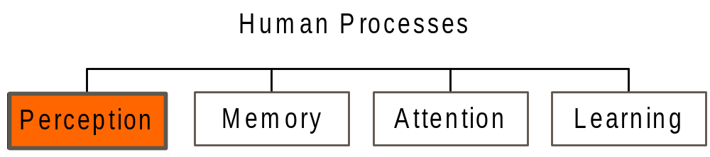
Cognitive Processes - Perception
Human Considerations

Slide 4
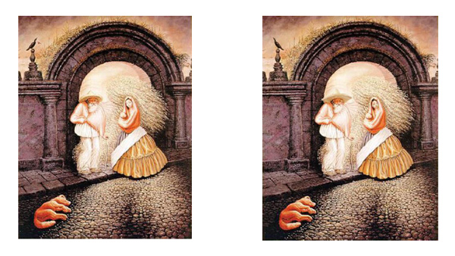
Cognitive Processes - Perception
Are these 2 pictures the same?
Human Considerations

Slide 5
Cognitive Processes - Perception
Perception is fundamental to interacting with computers
Perception can involve all the different senses (visual, hearing, touch, smell..)
To date, mostly concerned with visual perception because screen is usually the interface
Human Considerations

Slide 6
Cognitive Processes - Perception
Two classes of Visual Perception Theory
      Constructive
      Ecological
Human Considerations

Slide 7
Cognitive Processes – Perception
Constructive
Constructive perception: Anything perceived on a screen is also a result of our prior knowledge and expectations
Human Considerations

Slide 8
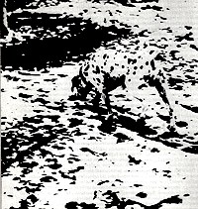
Cognitive Processes – Perception
Constructive Example
Human Considerations

Slide 9
Cognitive Processes – Perception
Constructive Example
Prior knowledge of what a dalmation looks like helps us to construct the image
Without prior knowledge, we would not able to make sense of the picture
Once we know what the picture depicts it is impossible to perceive it as random dots again, we have a meaningful interpretation
Human Considerations

Slide 10
Cognitive Processes – Perception
Constructive Example
Constructivism uses context to interpret and understand what we perceive
Not initially concerned with specific detail, more interested in the overall meaning of the scene
Human Considerations

Slide 11

Human Considerations

Slide 12
Cognitive Processes – Perception
Constructive Example
Which did you see – a seal or a donkey?
Human Considerations

Slide 13
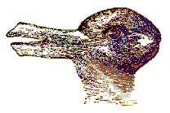
Human Considerations

Slide 14
Cognitive Processes – Perception
Constructive Example
Which did you see – a duck or a hare?
Human Considerations

Slide 15
Visual Perception
Constructive
Gestalt laws of perceptual organisation
‘Laws’ of perception that are regarded as being innate
  Proximity
  Similarity
  Closure
  Continuity
  Figure-Ground
  Symmetry

Slide 16

Visual Perception
Constructive
Proximity
  The elements appear as groups rather than a random cluster of elements
http://edition.cnn.com/ uses proximity

Slide 17
Visual Perception
Constructive
Similarity
  there is a tendency for elements of the same shape or colour to be seen as belonging together

Slide 18

Visual Perception
Constructive
Comment on the use of similarity in this photo ..

Slide 19

Visual Perception
Constructive
Use of Similarity (& Proximity)

Slide 20


Visual Perception
Constructive
Closure
  missing parts of the figure are filled in to complete it
http://www.youtube.com/watch?v=ne6tB2KiZuk - closure
demonstrated in a different way

Slide 21

Visual Perception
Constructive
Use of Closure

Slide 22

Visual Perception
Constructive
Use of Closure

Slide 23

Visual Perception
Constructive
Continuity
  The eye will naturally follow a line or curve

Slide 24

Visual Perception
Constructive
Use of Continuity

Slide 25
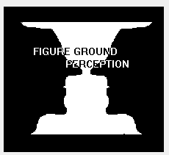
Visual Perception
Constructive
Figure-Ground
  Simplifies the visual scene into the figure that we look at and everything else is the background.

Slide 26

Visual Perception
Constructive
Symmetry
  regions bounded by symmetrical borders tend to be perceived as coherent figures
http://www.bbc.co.uk/news uses symmetry

Slide 27

Visual Perception
Constructive
Use of Symmetry

Slide 28
Cognitive Processes – Perception
Ecological
  Ecological theory argues that visual perception is a direct process

Slide 29
Cognitive Processes – Perception
Ecological - Affordance
A central concept of the ecological approach is the notion of affordance
When the affordance of an object is perceptually obvious (perceptual affordance), it is easy for us to know how to interact with it
When the opposite is true, we tend to make mistakes when trying to interact with the object

Slide 30
Cognitive Processes – Perception
Ecological - Affordance
Scroll bars - intuitive to dragging upwards/downwards
Door handle – good affordance for pushing/
pulling
Pull
Push

Slide 31
Cognitive Processes – Perception
Ecological - Affordance
Affordance is very important with regards to interface objects such as buttons, scrollbars etc. (direct manipulation systems)
How are affordances affected with flat design?

Slide 32


Exercise 1:
Let’s look at the following 2 websites. How do they use the Gestalt laws?

Slide 33
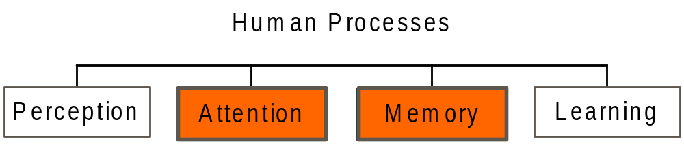
Cognitive Processes - Attention
Memory
Human Considerations

Slide 34
Cognitive Processes - Attention
Attention
Basic Forms
Of Attention
Multi-tasking
Automatic
Processing
Techniques to
Guide Attention
Human Considerations

Slide 35
Cognitive Processes - Attention
Basic Forms of Attention
Our ability to attend to one event out of a mass of stimuli is known as focused attention
We are also capable of divided attention, e.g. driving while holding a conversation
Attention may also be voluntary (we make a conscious effort to change our attention) or involuntary (a stimuli suddenly grabs our attention)
Human Considerations

Slide 36

Cognitive Processes - Attention
Human Considerations

Slide 37
Cognitive Processes - Attention
How do you think that a user can be more focused?
  One of the most important ways to help focus users attention to the information they need is to structure the interface so that it is easy to navigate through
  Also, the perceptual laws of grouping should be used so that information can easily be perceived
Human Considerations

Slide 38
Cognitive Processes - Attention
The following slide contains an example screen from a hotel information system
Answer the following questions from the example screen
  What is the phone number of the Days Inn in Charleston?
  Name the hotel that offers a double room for $33?
Human Considerations

Slide 39
Room
City Hotel Phone Single Double
Charleston Best Western 575-3454 $23 $39
Charleston Days Inn 878-3423 $20 $34
Charleston Holiday Inn 234-4623 $36 $46
Charleston Howard Johns 342-5728 $33 $47
Charleston Ramada Inn 387-4523 $18 $28
Charleston Sheraton Inn 764-5879 $40 $80
Charleston Marda Hotel 476-5876 $26 $38
Columbia Best Western 422-7567 $32 $50
Columbia Carolina Inn 336-8711 $20 $25
Columbia Holiday Inn 761-4765 $22 $33
Columbia Howard Johns 487-8232 $34 $40
Columbia Quality Inn 471-4762 $20 $35
Columbia Ramada Inn 479-9897 $33 $47

Slide 40
Cognitive Processes - Attention
The following slide contains an example screen from a different hotel information system
Again, answer the following questions from the example screen
  What is the phone number of the Holiday House?
  Name the hotel that offers a double room for $27?
Human Considerations

Slide 41
Pennsylvania
Bedford Motel/Hotel: Crinoline Courts
342-4657 S:$18 D:$28
Bedford Motel/Hotel: Holiday Inn
465-3865 S:$29 D:$36
Bedford Motel/Hotel: Midway
763-8623 S:$21 D:$26
Bedford Motel/Hotel:Penn Manor
654-9987 S:$18 D:$25
Bedford Motel/Hotel: Quality Inn
764-8766 S:$22 D:$29
Bradley Motel/Hotel: Holiday House
777-9898 S:$28 D:$24
Bradley Motel/Hotel: De Soto
7798-9836 S:$22 D:$25
Bradley Motel/Hotel: Holiday Inn
733-9851 S:$32 D:$27
Breezewood Motel/Hotel : Western Plaza
837-9373 S:$28 D:$29

Slide 42
Cognitive Processes - Attention
In this example, the way information is structured at the interface has a major impact on our ability to find and attend to information
In the original study, (Tullis 1984) average search times for a single item were 3.2 seconds for the first screen and 5.5 seconds for the second
In the first screen, information is easier to find:
  similar information has been grouped into categories
  spacing is employed to facilitate the perceptual process
Human Considerations

Slide 43
Cognitive Processes - Attention
What is Multitasking?
Human Considerations

Slide 44

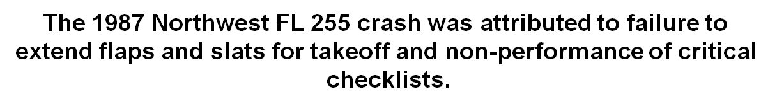
Cognitive Processes - Attention

Slide 45
Cognitive Processes - Attention
Automatic Processing
Many activities that we carry out regularly become automated, we do them without really thinking about them
Cognitive processes can also become automatic with practice
Automatic cognitive processes are identified as
  fast
  demanding minimal attention and hence don’t interfere with other activities
  unavailable to consciousness
Human Considerations

Slide 46
Cognitive Processes - Attention
The classic example used to demonstrate the phenomenon of automatic cognitive processing is the Stroop Effect
Human Considerations

Slide 47
XHFG
EJHFU
EEF
KJBVN
DJEBSI
DJVBY
DKSNVL
SKHJSHE
FJJVN
EIJHFH
KSNNC
DSKA
KD
VNNVJR
EFJJIE
VKJNDS
EOEUJ
DJNVK
SSXZ
DJSD
DFJJNV
EIUGHBV

Slide 48
RED
YELLOW
BLUE
BLACK
GREEN
YELLOW
BLACK
RED
BLUE
GREEN
RED
GREEN
YELLOW
BLACK
GREEN
YELLOW
BLUE
RED
YELLOW
BLUE
GREEN
BLACK

Slide 49
Cognitive Processes - Attention
It should have taken longer to say the colour names in the second list
This is because in the second list there is a conflict between the automatic process of reading the words and the automatic process of perceiving the colours
Difference between automatic and non-automatic cognitive processes
  Automatic processes are not affected by the limited capacity of the brain
  They require little attention and are extremely difficult to unlearn
Human Considerations

Slide 50
Cognitive Processes - Attention
Implications for HCI design
Consider a user who has learned a set of keyboard combinations for a particular word processor to the extent that they have become automatic processes
If key combos have been changed -> major effort for the user to unlearn their automatic processes
Leads to much frustration on the part of the user
Potentially dangerous in critical applications such as process control plants
Human Considerations

Slide 51
Terms of Reference
    Norman, D. (1990) The Design of Everyday Things
    Preece, J. et al. (2002) Interaction Design
    Shneiderman, B. & Plaisant, C. (2005) Designing the User Interface
    Benyon, D. et al (2005) Designing Interactive Systems
    Craik, K. (1943) The Nature of Explanation
References

